Slide 1

PBEL Virtual Internship
Project Title:Weather Forecast
Submitted By:
Submitted To:
Name- Shivangi Mishra
Name-Mr.Deepanshu Kumar
College-United College Of Engineering& Research
Roll no.2400100100454

Slide 2
Declaration
I hereby declare that this project report titled “WEATHER FORECAST” is a result of my own carried out during the IBM PBEL Virtual Internship .The project is original,and no part of it has been copied or submitted elsewhere for any other course or internship.
Acknowledgement
I would like to express my heartfelt gratitude to my project guide,Mr. Deepanshu Kumar for their valuable support ,guidance,and encouragement the project. Their constructive feedback and constant motivation helped me complete this internship successfully.
I also extend my sincere thanks to the IBM PBEL team for offering this incredible opportunity to gain practical experience.My appreciation also goes to my college, United College Of Engineering & Research ,and my peers who supported me during this course of this internship.

Slide 3
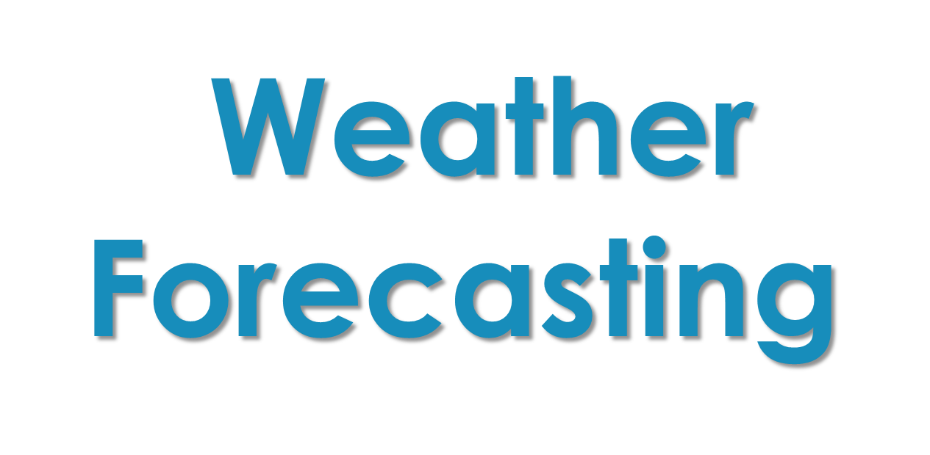

Slide 4
Contents
Procedures of Weather forecasting
Project Aim
Project Specification
Deliverables
Use Case Diagram
UI diagram
Limitations
Application Screenshots

Slide 5
Procedures of Weather forecast
The weather forecasting has now become a science and it is performed by adopting the following procedures (steps):
Weather forecast is the application of science and technology to predict the conditions of the atmosphere for a given location and time. Weather forecasts are made by collecting quantitative data about the current state of the atmosphere at a given place to project how the atmosphere will change. The role of Technology has been remarkable in the field of weather forecasting.

Slide 6
Project Aim
To make a real time weather application that takes user’s exact location and provides weather forecast for the day and upcoming days also. We also tried to design a simple but visual UI that provides comprehensive data. Also the application provides suggestions to users based on weather conditions. And lastly, user can search and access data for custom locations (string based).

Slide 7
Project Specification
Real time weather forecasting.
Takes user’s geolocation as input to provide weather forecast
App will predict weather changes with a per minute accuracy based on the user current location.
Displays detailed weather information for five cities.
Can also take custom location as input to provide weather details for that location (Google Manual Search API).
RapidAPI is used to fetch data.

Slide 8
Deliverables
A properly working and executable. File that will run in any device.
A documentation that will provide details about the requirements, specifications and other information.

Slide 9
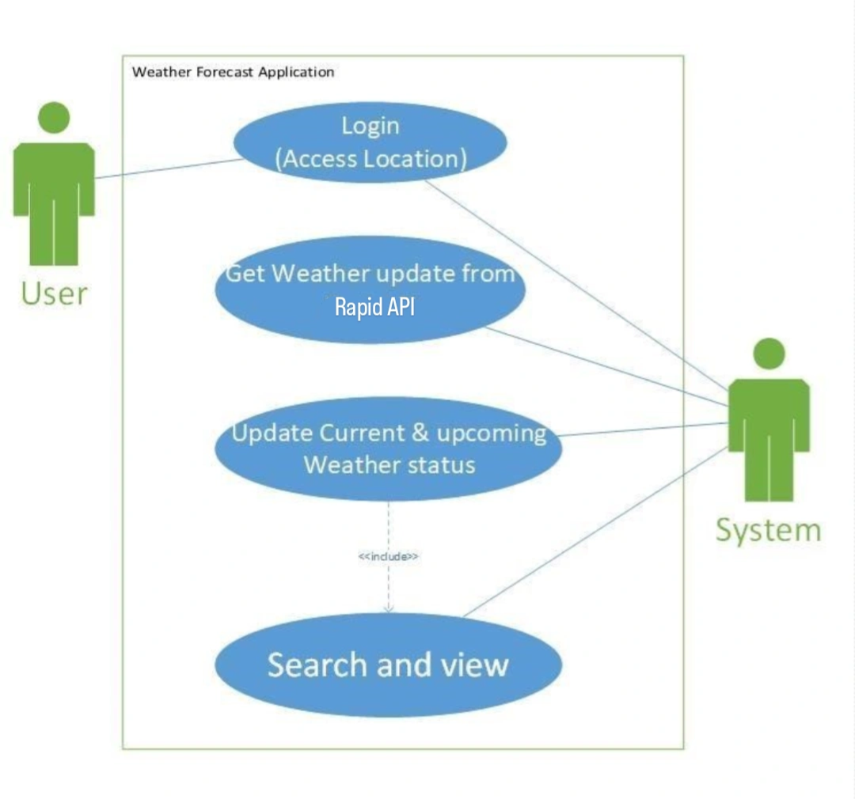
Use Case Diagram

Slide 10
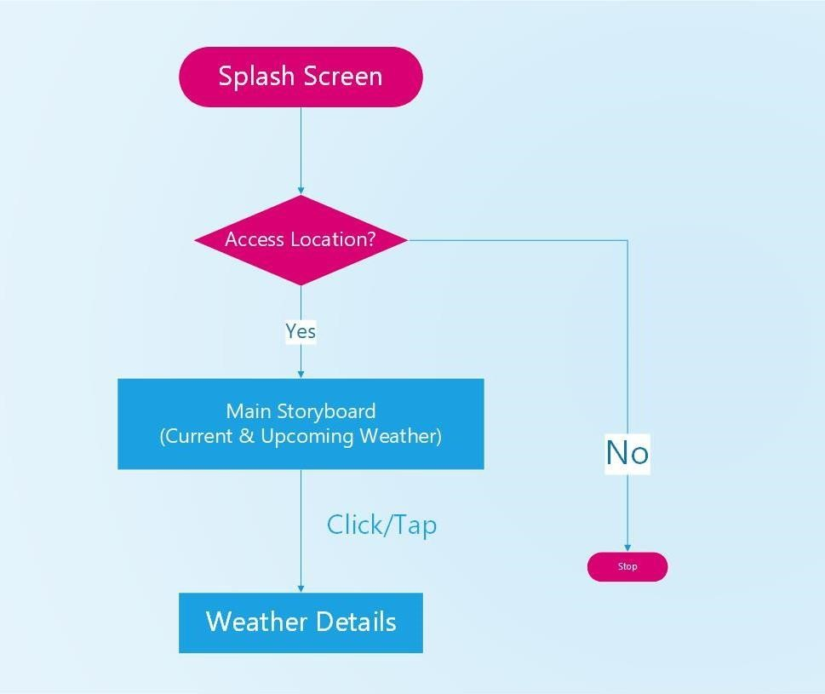
UI diagram

Slide 11
Limitations
Unpaid APIs provide incomplete services. Many details cannot be fetched
The GMS API ( Google Manual Search) is actually keyword based that might only provide data of few discrete locations. The data might not be precise and continuous
Language diversity could have been implemented. Multilingual apps make it easy for users worldwide

Slide 12
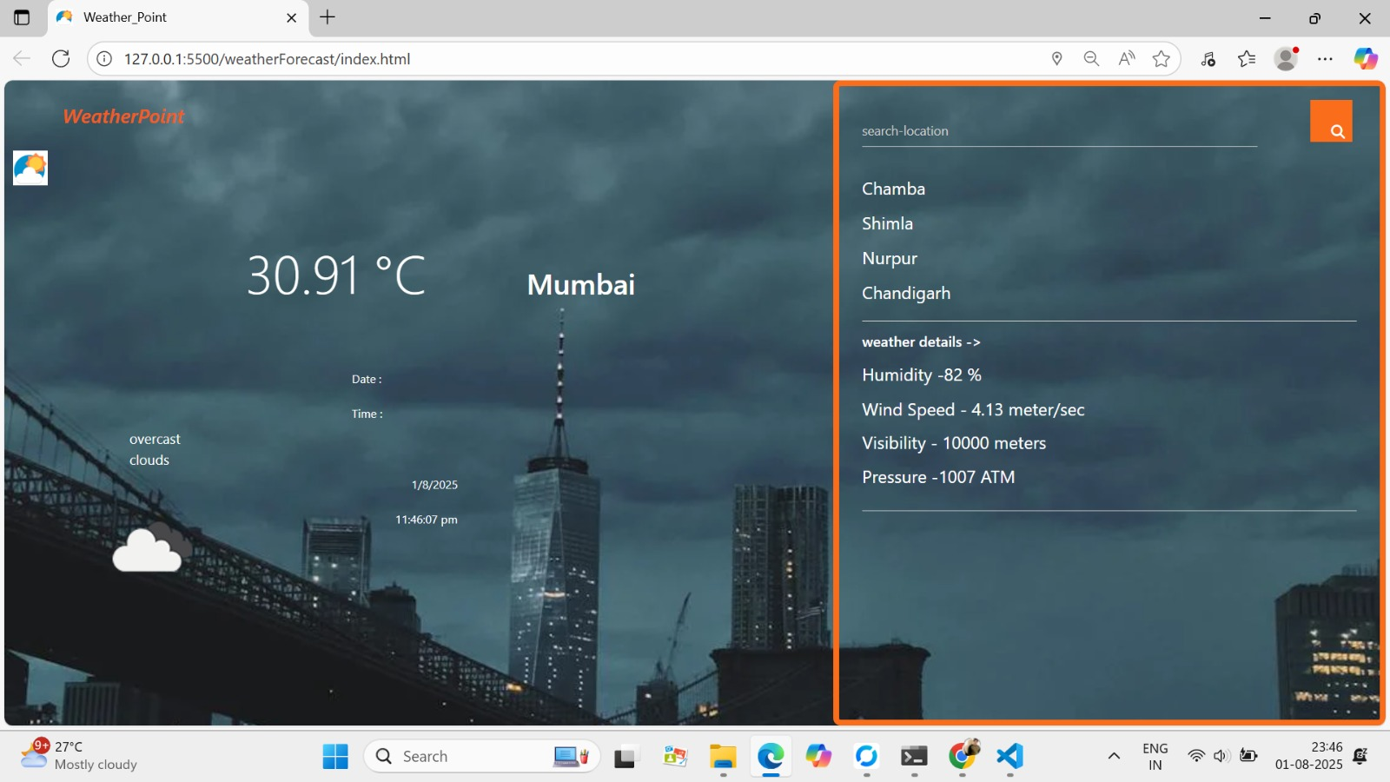
Application Screenshots
Weather-forecasting-app

Slide 13
Thank you

